Slide 1
Data Preparation for Accounting
Module 3
Ron Guymon & Linden Lu

Slide 2
Agenda
Live Session Quiz
Coursera Q & A
Cheat Sheet
Coding Challenges
For Next Week
Tips for the High Engagement Assignment
Notes:
Transition: Let’s start with the quiz. I think that may help refresh your memory to see if you have any questions…

Slide 3
Live Session Quiz
https://forms.gle/1ECFJz8PD3g88ip46
Notes:
Survey url: https://forms.gle/1ECFJz8PD3g88ip46
Why is it important to learn about strings, tuples, lists, dicstionaries, and loops?
What is the data type of the following script: [4,6,8,10]? List
Python uses zero-based indexing to refer to items in a sequence. Using a zero-based index, which account has an index of 3 in this list of account names: "accounts receivable", "cash", "revenue", "bad debt expense”? ”bad debt expense”. Point out that it takes three steps from the first item in the list.
Using a zero-based index, which account has an index of -3 in this list of account names: "accounts receivable", "cash", "revenue", "bad debt expense"? “cash”. Interesting how there’s not a zero base when starting from the right side.
Have you ever used the concept of loops in Excel, VBA, or any other task that you've done? If so, what do you find to be the hardest aspect of creating loops? For me it’s either the transition from the end of one loop to the beginning of another, or keeping track of variable names when creating nested loops.
Briefly consider the VBA "Cheat Sheet", or quick reference guide above. If you were to create a cheat sheet for what we've learned so far in Python, what is one category that you have a hard time remembering and that you'd want to include? See if there are any to add to the cheat sheet.
Transition:

Slide 4
Questions About Coursera Content?
Notes:
Terms
Shallow copy vs deep copy (3.1, List):
Unpacking (3.1, Tuple):
Tokenize (3.2, Substring Manipulation): convert every element to an item in a list.
Functions vs methods (3.2): I think methods are added onto an object, while functions take objects as parameters.
In place (3.2, List): Doesn’t create a new object.

Slide 5
Another Comment About OOP: Functions and Methods
Why does this code work?
string1 = ‘voodoo economics’
string1.count(‘o’)
6
Answer: the count method is a function that is inherited by all strings.
Notes:
Remember how in module 2 there was a slide that had a comment about OOP? I mentioned how OOP reduces complexity and increases usability by reducing the amount of spaghetti code. It does this by encapsulating variable names and functions into a special object called a class.
At this point, you may be wondering why some functions are called by adding a period to the end of a variable, and then the name of the function. These are formally known as “methods”. Methods are functions that are built in to objects. Different classes of objects have different methods that can readily be used and quickly called for all members of a class.
So, why does string1.count(‘o’) work? Because it’s a method, or function, inherited by all strings.
Let’s use a car as an example of a class. If it were a class, then it may have built in variables, or attributes, like the amount of fuel in its tank, and its max speed. It may also have built-in functions, or methods—actions—that should be expected by all cars. For instance, driving, knowing the speed, setting cruise control, refueling, etc.
Thus, strings, tuples, lists, dictionaries, and dataframes have certain functions built into them by nature of their class. We’ll refer to them as functions, but recognize that you call them in a different way than functions you create, or that have been created for use with lots of classes.
Transition:…

Slide 6
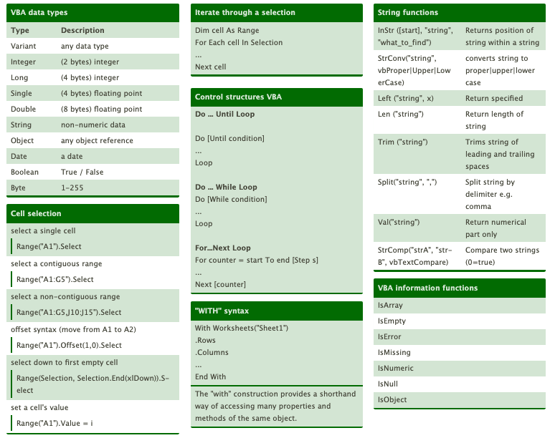
Cheat Sheet Creation
Please do the following in small groups:
Receive a topic.
Create a section of a cheat sheet for that topic.
Take a screen shot of that section and chat it in to the rest of the class.
Notes:
Show students an example cheat sheet from another domain, like VBA:
Ask them to get together in groups of two and come up with a section. Assign each group a topic. Have them gather back together to combine all the parts. Here are some topics:
Functions
Loops (could break into for and while if we need more topics)
Conditional statements
Strings
Lists
Tuples
Dictionaries
A great place to look is in the notebook readings for modules 1 and 2 (for data types), and in module 3 (for loops).
The second one on this site is a good one for the students at this point: https://ehmatthes.github.io/pcc/cheatsheets/README.html
Ask each team to take a screen shot and then send it in where Linden or I will paste it together into a single document.

Slide 7
Coding Challenges
This challenge is related to reading in a Quickboooks journal export, and converting it to a tidy dataframe.
Notes:
Perhaps show a clip from Groundhog Day when Phil Connors keeps waking up day after day.
Make a notebook available on Compass2g that students can download. It should have a variety of relevant coding tasks to complete.
Consider chatting out a few lines of code at a time so that they don’t scroll down and see everything.

Slide 8
Module 3 Takeaways
Strings, Tuples, Lists, and Dictionaries are some of the most commonly used fundamental data types.
Different data types have different built in functions (methods) to perform common operations.
Loops are lovely.
Notes:
There are other data types that we’ll talk about next time, but they’re not fundamental.

Slide 9
Module 4 Preview
Python Modules
NumPy
Pandas
Notes:
Transition: Linden will now share some tips for completing the first high engagement programming assignment…

Slide 10
Tips for Module 3 High Engagement
Notes:
Linden will communicate the tips here.

Slide 11
Questions?

